Slide 1
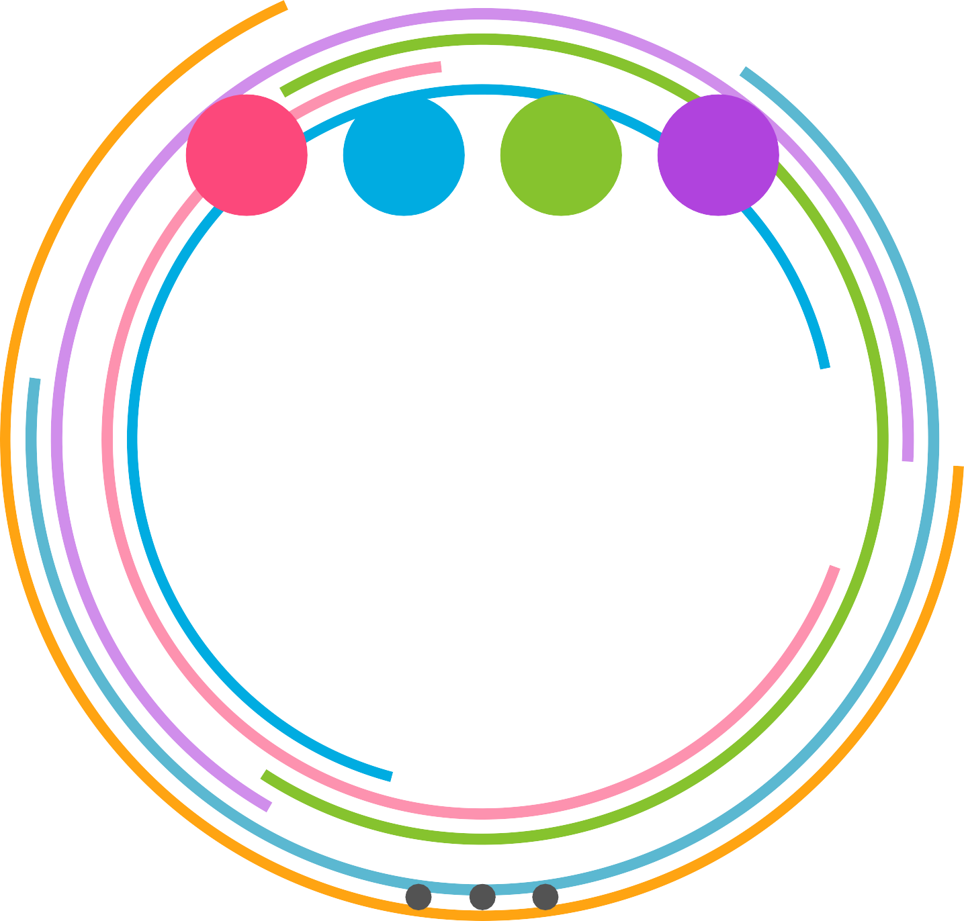
SWP-COVID19
TECHSTERS
Society Welfare Portal For COVID19

Slide 2
TEAM TECHSTERS
Animesh Kumar Shukla
Nilesh madharia
Jasleen kaur

Slide 3
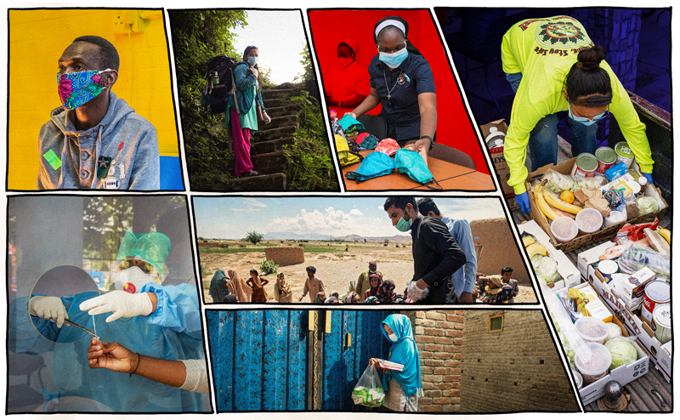
PROBLEM STATEMENT
Society Welfare Portal For Covid-19
The lack of transparency in this pandemic situation is being considered as boon by the fraudsters and black marketers. The people are out to help but are unable to reach the needy. So Develop a e-enabled designed to make a direct connection between the needy and the helping hand contributors.

Slide 4
PROBLEM SOLUTION
SWP-COVID19 is India’s peer-to-peer resource sharing platform. It was started in April 2020 during the on-set of the COVID-19 lockdown in India. It brings the concept of helping your neighbor at a time of need – to a virtual space. Users can connect with others in their community by placing requests for essential resources.
This way, SWP-COVID19 has created a unique networking space to connect community ‘superheroes’ with opportunities to make a difference.
Beyond essential resources, the platform also aims to help people build each other by giving users a space to list services they would like to provide to their community.

Slide 5
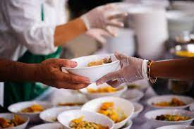
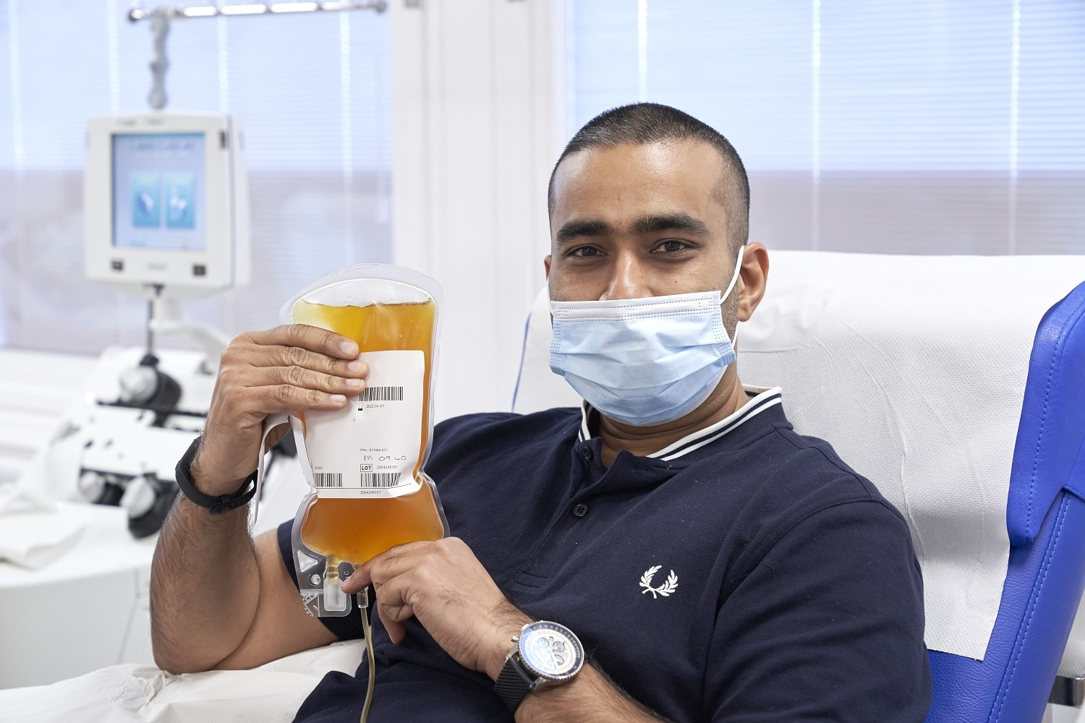

KEY FEATURES
Providing Personalized and Social Services:
Specifying a Query(as donor or Needy )
Accessibility to Needy
No third party involvement (Except Government)
Connecting People to Government Polices and NGOs
Absolutely Free Service to Underprivilege
Detailed Data Analysis
24x7 volunteer in Emergency
Dedicated Team
Verified Process

Slide 6
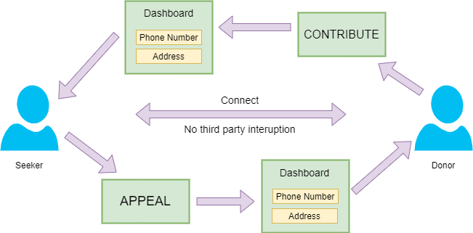
FLOW DIAGRAM

Slide 7





FUTURE SCOPE
Navigation
using Google Map APIs
OTP Verification Of Users
Chat Bot for advisories
Tracking Realization Of Requesties

Slide 8
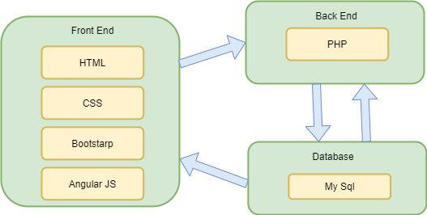
TECHNOLOGY STACK

Slide 9
SCREEN SHOTS

Slide 10
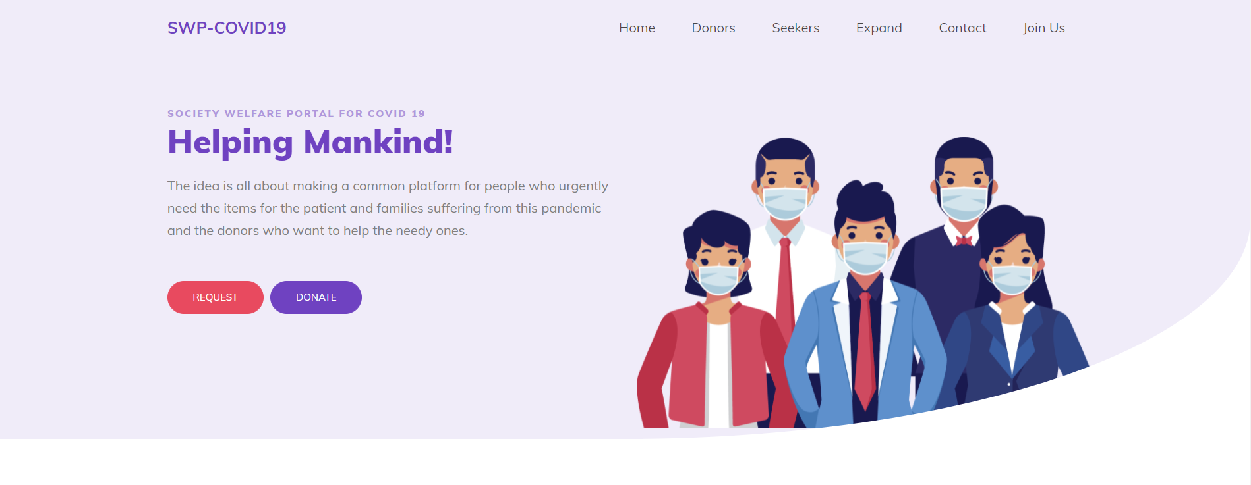
HOME PAGE HEADER

Slide 11
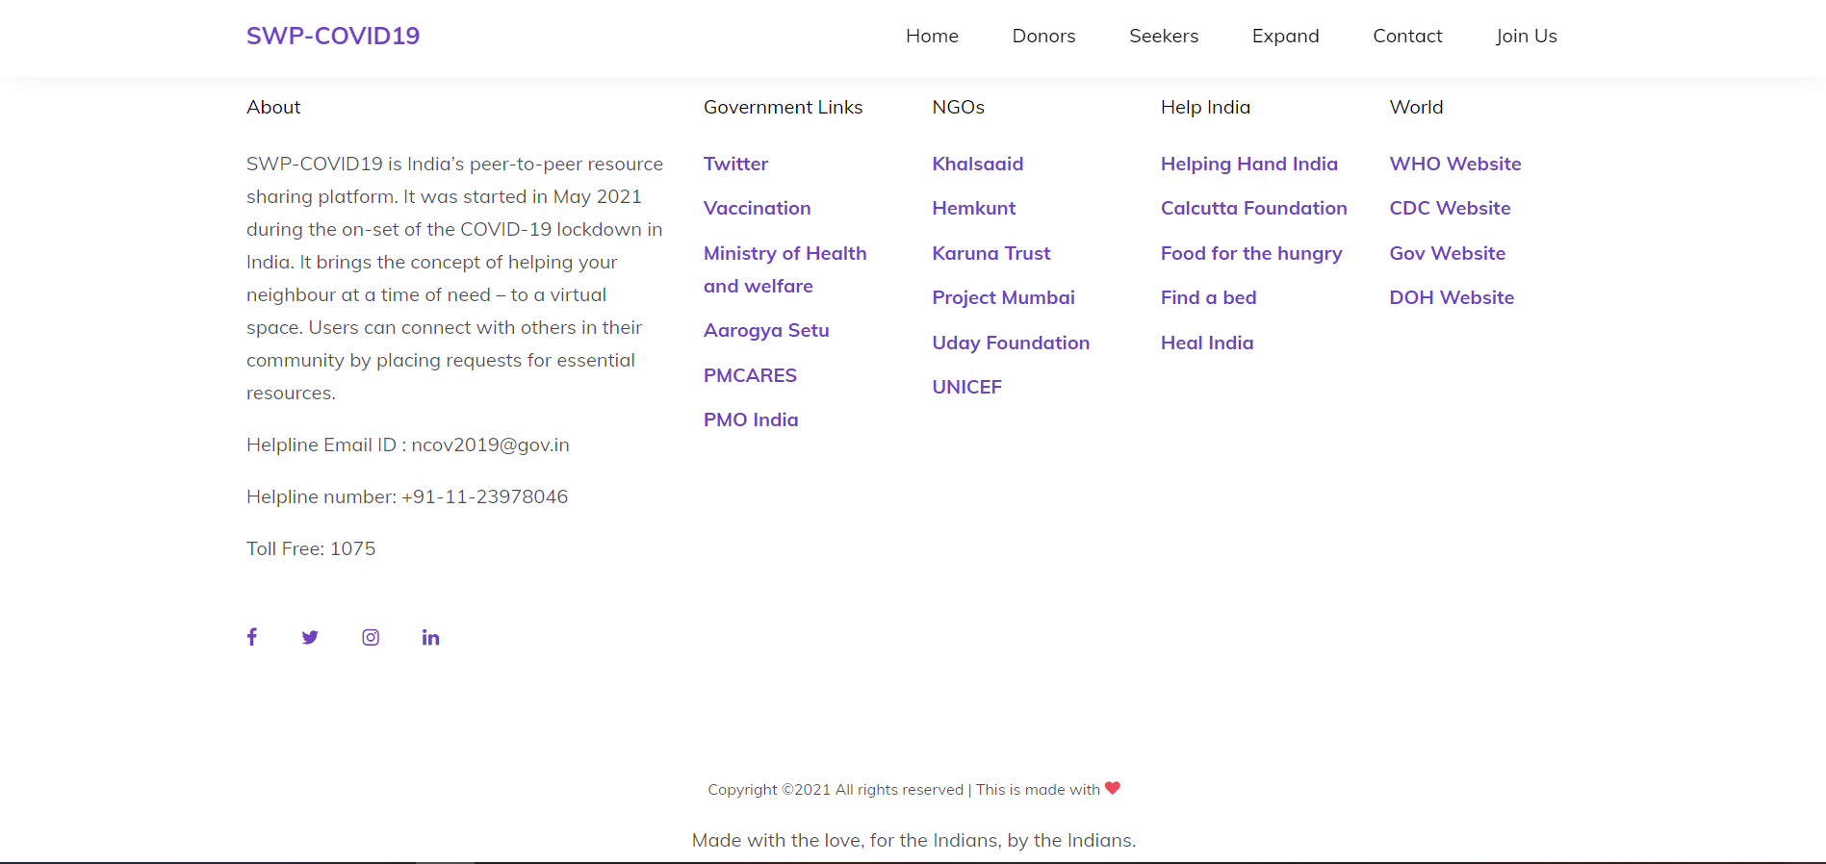
HOME PAGE FOOTER

Slide 12
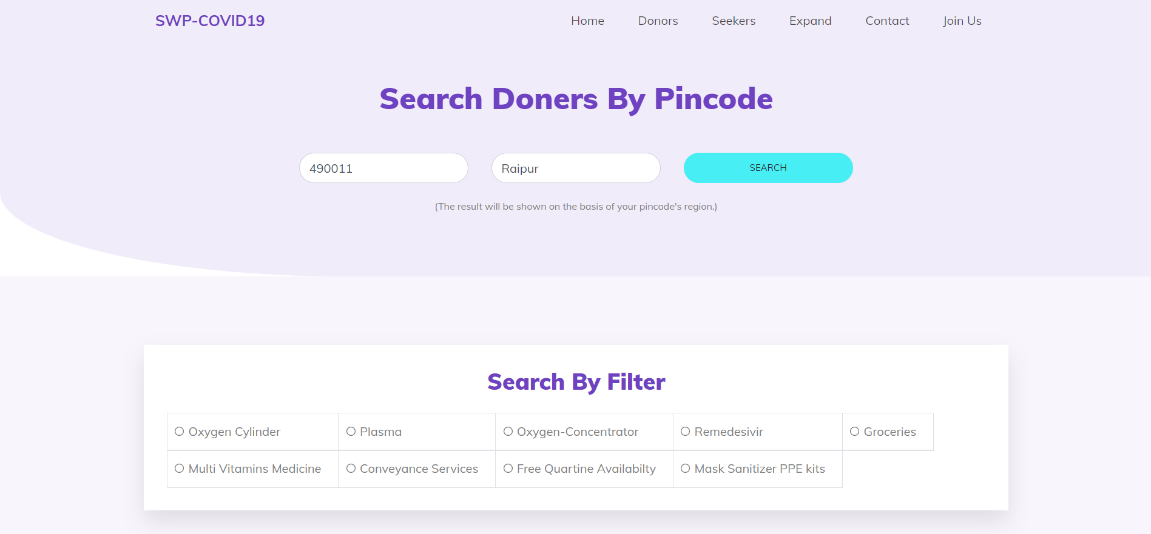
DONER SEARCH PAGE

Slide 13
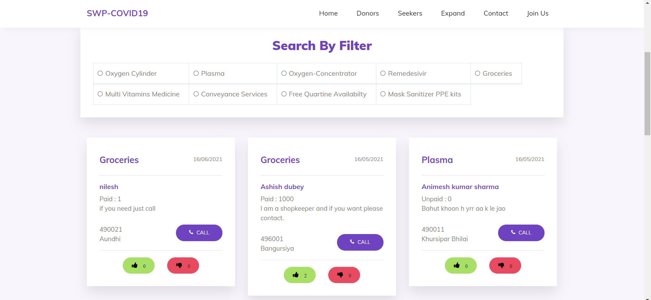
DONER SEARCH PAGE

Slide 14
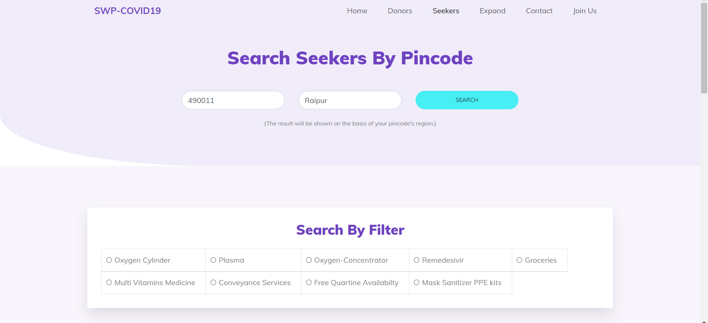
SEEKER SEARCH PAGE

Slide 15
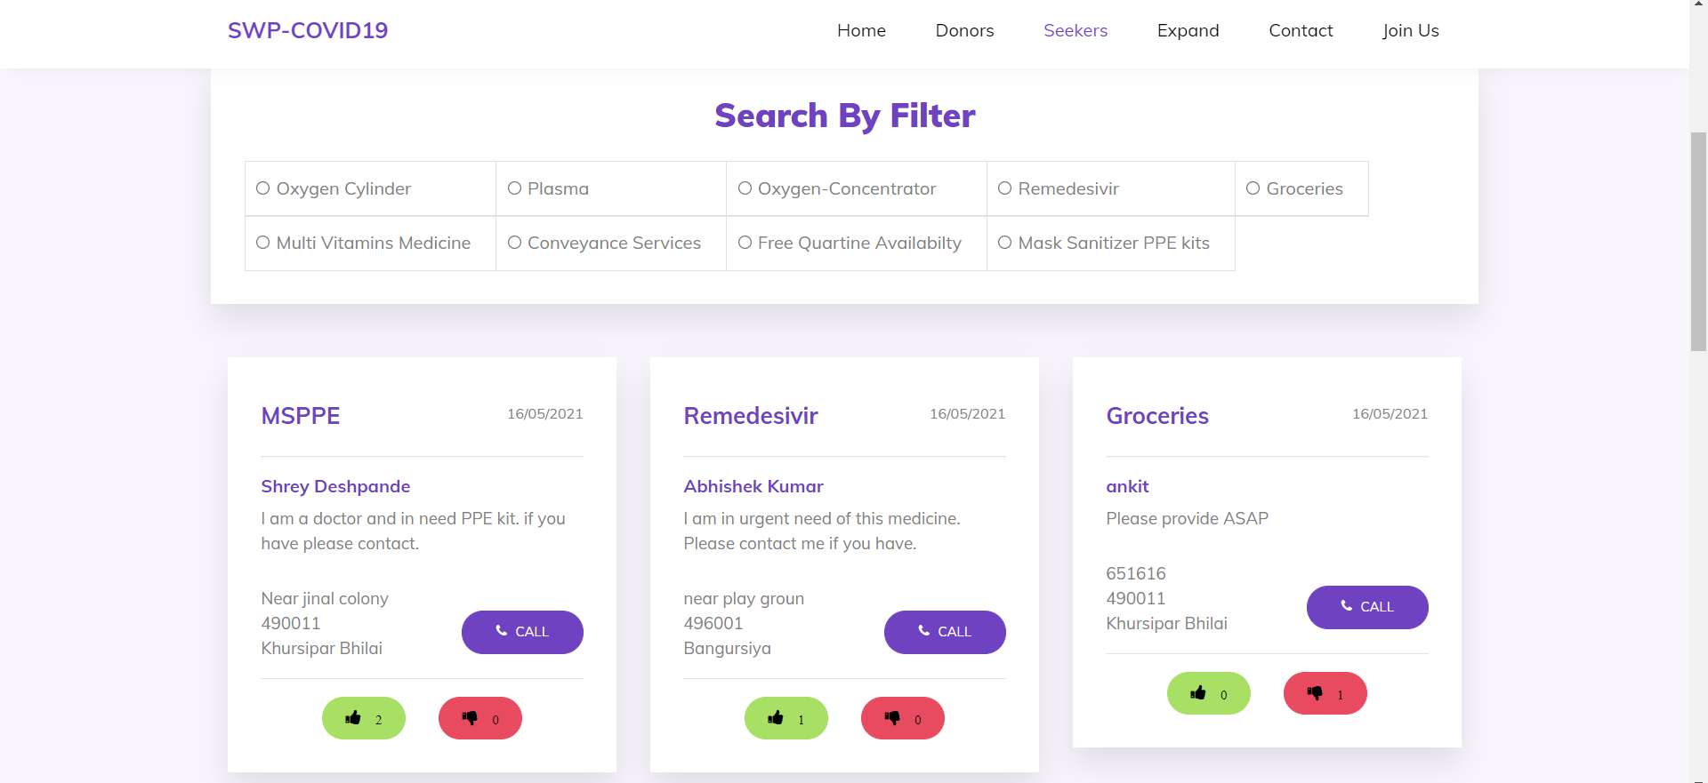
SEEKER SEARCH PAGE

Slide 16
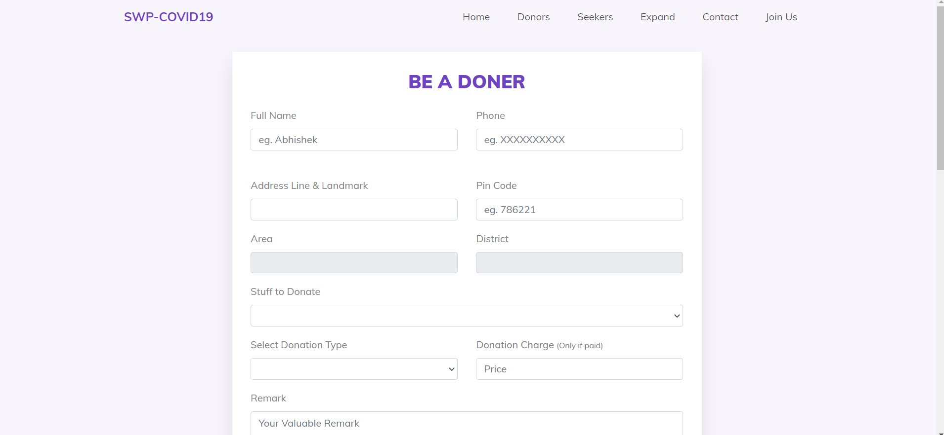
DONATION FORM PAGE

Slide 17
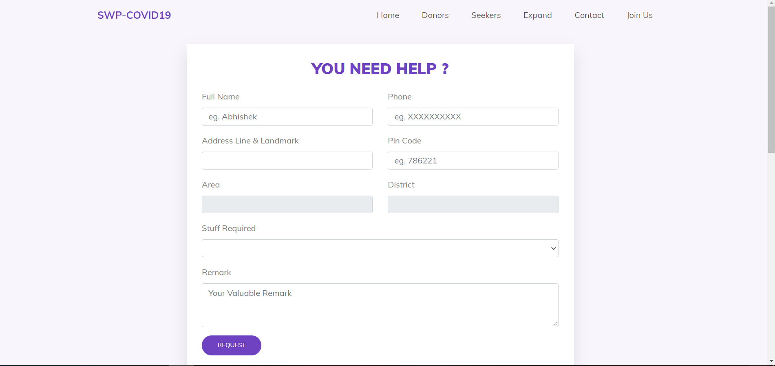
SEEKER REQUEST PAGE

Slide 18
DATABASE TABLES

Slide 19
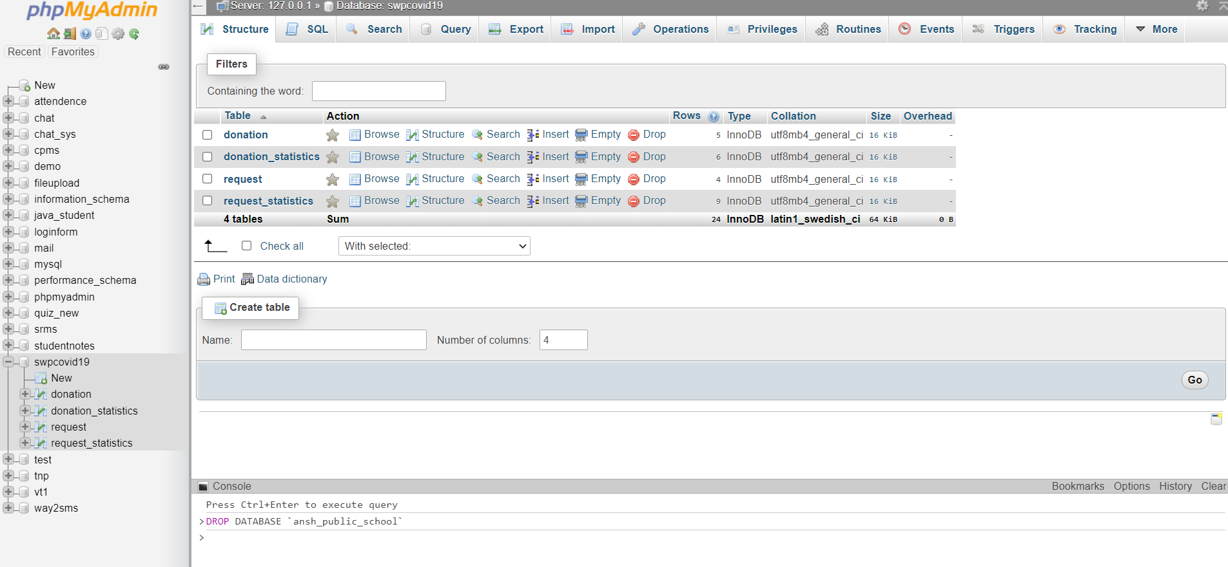
DATABASE TABLES

Slide 20
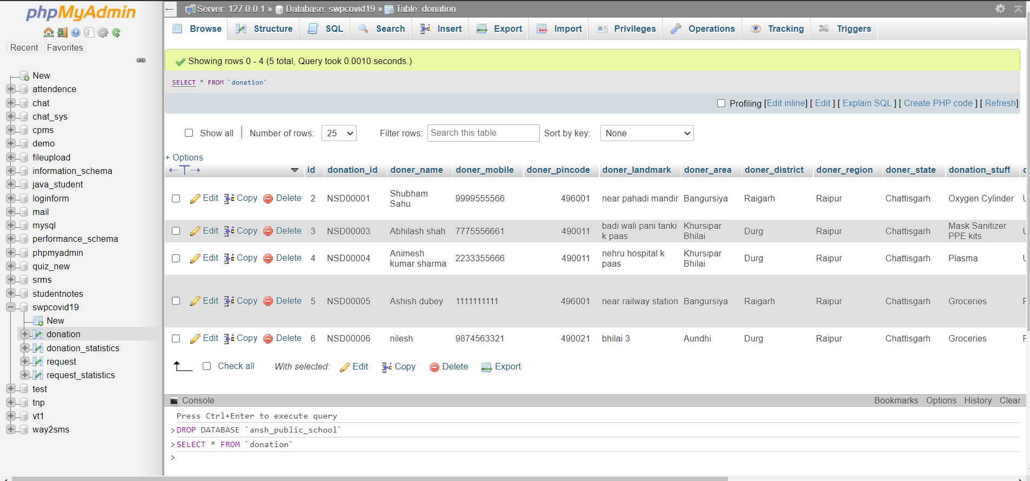
DATABASE TABLES

Slide 21



Thank You ☺

